Slide 1

Literary romances and professional boundaries
Author relations, boundary work and the construction of publishing profession
Anne Mölsä
Tampere University
Notes:
In this presentation, I will explore the boundary work of publishers of Finnish literature. I am especially focusing on their meaning-making considering author relations. I will show how the ideal of intimate author-editor relationships and the ways of constructing publishing as a work “above the ordinary” lives on in publishers meaning-making. At the same time, the publishers extensively draw boundaries between themselves and the authors, constructing the two groups as fundamentally separated.

Slide 2


Dissertation on publishers of literature
I am studying how publishers of Finnish literature construct themselves as a professional group and how authorship is produced in the process
The approach combines cultural studies, media studies and sociology of literature
The data consists of 16 interviews with the editorial staff (editors, publishing managers and publishers) and 14 observations of work situations (meetings, book fairs, book launch parties, events)
Large and mid-size trade publishers

Slide 3
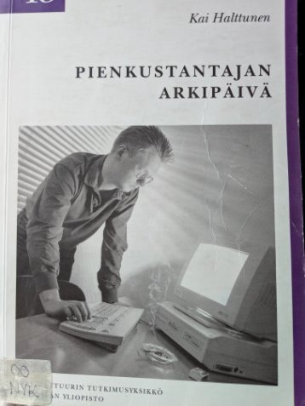
The unexplored mystery of the Finnish publishing field
"The Everyday Life of a Small Publisher", 1995
Notes:
The picture here is the last qualitative, scientific research conducted in the field of Finnish publishing studies
Note the modern technology and the smoking cigarette on the table (nobody has smoked indoors in Finland since the early 2000s or so...)
So how come the publishing studies has been almost non-existent in the Finnish context?
The main reason might be that there is no such thing as “publishing studies” taught in the Finnish universities and no natural research environment for this vein of study
The lack of formal education affects the whole publishing field as there is no professional education leading to work in the publishing sector.
Editors working in the literary publishing sector usually have a Master's degree in literature – and some are even former literary scholars. They come to work in publishing through internships and learn the profession at work.
Professional codes, such as ethical rules, are not explicitly formulated anywhere (whereas other fields of publicity like journalism and advertising have their own ethical codes)
So, the publishing profession in Finland is very much constructed in the daily practices and meaning-making of publishers which makes it even more crucial to study them

Slide 4
On professions
Profession: distinct and generic category of occupational work (Evetts 2013, 781)
Profession becomes possible and "natural" in the process in which the world's complexity and incoherence is transformed into integrated, separate and neat patterns (Fournier 2000, 71)
Professions don't just reflect the reality they claim to "know about": the object of knowing doesn't exists separately from the professional gaze, but is produced by the professional practice (ibid., 72)
It is crucial to study how publishing becomes "natural" in the professional's everyday work and meaning-making
Notes:
There has been a long academic discussion about the nature of "profession", but there is no time to engage in it here. So, it is enough to say that I regard literary publishing as a distinct category of occupational work that has its own features to be studied.
Organizational researcher Valérie Fournier has written about how professions are produced in a process of cultural meaning-making
Fournier says that profession becomes possible and "natural" in the process in which the world's complexity and incoherence is transformed into integrated, separate and neat patterns
According to Fournier, it is important to understand the nature of this process because firstly, it shows that professions don't just "reflect" reality they "know about" and act on, and secondly, professional knowledge is rather malleable than firm -> the object, that the profession claims to know doesn't exists separately from the "professional gaze", but the professional practice produces it.
In literary publishing, the "object of knowing" is literature and authorship: the "professional gaze" of publishers also produces these things
In this presentation, I will focus on how publishers produce authorship in the interview data

Slide 5
Boundary work
Christina Nippert-Eng: "Boundary work consists of the strategies, principles and practices that we use to create, maintain and modify cultural categories"; "Boundary work is what allows categories and classification systems to exist, to be meaningful, and to change over time" (1996, 564)
Valérie Fournier: Professions as consequences of 'labour of division' rather than 'division of labour' (2000, 73)
Notes:
In order to examine this, I will utilize the concept of boundary work
Sociologist Christina Nippert-Eng has provided a viable definition on boundary work: "Boundary work consists of the strategies, principles and practices that we use to create, maintain and modify cultural categories"; "Boundary work is what allows categories and classification systems to exist, to be meaningful, and to change over time" (1996, 564)
Valérie Fournier has written about how professions are constructed through boundary work and has insightfully observed that professions could be considered as consequences of 'labour of division' rather than 'division of labour'
Next, I will take a look on the boundary work that publishers of literature do when they talk about their relationships with the authors
The aim here is to examine, how the cathegories of "author" and "publisher" are utilized in order to draw and redraw the boundaries of publishing profession.

Slide 6
Data examples
Notes:
Next, I will show some data examples and analyse them
The analysis is based on thematic analysis that I have conducted and supplemented with a special focus on boundary work
I will read all t

Slide 7
Professional intimacy
One downside probably has to do with the fact that the editor is always a representator of an institution, and at the same time you’re supposed to have pretty straightforward and even friend-like relations with the authors, or kind of close ones. And the more intimate and familiar the editor-author relationship is, the better the work tends to flow. However, at the same time, there’s this position of authority that requires keeping a certain distance. And there are things related to, for example, publishing decisions or how books are marketed or what’s being done with them in-house, I’ve got things that I cannot disclose externally. So, you’re supposed to be a really nice guy, and at the same time you must, ex officio, hold back what you say and what you don’t. It’s kind of hard to combine, or even impossible. (Niko, editor)
Notes:
The first quote is by an editor Niko
Quote
Additionally, Niko says, that there are things that the editors are not allowed to discuss with the author, and he sometimes has to advice the author to contact his superior or the marketing team. That's why the relationship cannot be "a true friendship" but it is "a professional relationship"
In this quote, the boundary between the author and editor is a problematic one. The demands of keeping the distance and being intimate are both present, which makes the dual role "hard" or "even impossible" to combine.
This disposition produces an urgent and unresolved need of boundary work, but in the end, everything comes back to "being professional"
Here, professionality is what resolves the dilemma of intimacy and distance: the professionality of the relationships makes it possible to have "friend-like" relations while at the same time the relationship is defined by the editor's authority, keeping the distance, and the editor's insufficient mandate to share some of the "insider knowledge" about publishing process​
Professionality is defined by distance, but also by intimacy. The "friend-like" relations are important, not because Niko would want them, but because they help the work to flow
The publisher's ability to place themselves in a close relationship with the author is constructed as a central sign of "good work" in the data
The question why the author shouldn't know certain things about publishing decisions and marketing, remains open. All in all, the idea of the publishing house as "the inside" and author as "the outsider" is not really problematized in the data. Niko's word , that there is information that he can't share externally, is telling: here, the author is not "on the inside".
Sharing information and refusing to do so is a concrete way to draw a boundary between author and publisher. Knowledge is power, and the possibility and choice to hold back information is usage of power.

Slide 8
The emotionally needy author
(--) most often [the difficult situations with authors] have to do with the fact that (--) the relationship is so confidential and author's work is so personal and authors reveal themselves in their work, so I have had the experience that it's easy for the author to slip into trying to get the editor's support for all kinds of challenges in life. So the author might have quite a low threshold of talking about things that maybe should be shared with a close friend or even a therapist. (Simo, publisher)
Notes:
Here, the author is presented as someone needy and fragile, whereas pubisher is the protector of "professional boundaries" of the relationship
This kind of disposition is fairly common in the data and it is often framed as a problematic element in publishing work

Slide 9
Author in transference
And then there are all these crush-type things and such, that of course shouldn't be let (laughs) to flare up in any way. But it's such an intriguing thing, the editor-author relationship, especially (--) if the editor is really excited about the manuscript, and particularly if it's a first-time author, it must feel kind of intoxicating that someone sees you so completely, and how excellent you are. So then it might, or I've heard that these kind of crushes can develop. But then, of course, a mature publishing professional (Anne giggles) draws a line when it comes to these things. (Viivi, publishing manager)
Notes:
The way of constructing the author as more emotionally needy is also present in the next quote by senior editor Viivi
Quote
Viivi is talking about a crush in a romantic sense
Also here the editor is a rational guardian of the professional process (even though this is also brought to ironic light); author, then, is shown as someone captured by emotions and the artistic processes
Again, the author is the one experiencing intoxicating feelings while the publisher's duty is to take care of professional boundaries
The same interviewee compared the author's crush to the transference between a therapist and the patient. In transference the patient develops feelings for therapist during the therapeutic process, but actually these have to do with something else than the therapist as a real person
The editor who understands author's text sees the author and her excellency "completely" - the text and the author are identified

Slide 10
Author as an exception
(--) he was so vital and full of creative energy. And each version of a manuscript was like I was reading a completely new one. Sometimes I felt totally exhausted (laughs, Anne also laughs) because I just couldn't take a new one, I don't even recognize this, I guess the characters were the same, I guess these things happened, but everything had been reworked. And he was very, kind of magical, one of a kind, he lived in his own reality, really. It felt like I could see some kind of original source of creation through him, how the text just bubbled up from there. He really was a sorceror in that way. (Ronja, publishing manager)
Notes:
However, there are also interesting examples where the boundary isn't really drawn between author and publisher, but rather on the outside: the boundary work can also be made in a way that constructs author and publisher as a dyadic whole
The way of speaking about the author as someone "special" is recognizable in the data also more broadly
In Ronja's quote, the author is described as "magical" and even a "sorceror" - someone who allows the publisher to see "the original source of creation"
I read this way of speaking as a kind of romanticism: the author-editor relationship is described as something above the ordinary life
Here, the boundary with the author seems to get blurred: the professional distance is not as important as it is to join the author in order to enter the magical realms of creation
Here, the author and publisher seem to form an intimate dyad which is described to be highly rewarding to the publishing professional

Slide 11
Getting famous with the famous
(--) at that point I had only worked few years full-time [in the publishing house] (--). So that case was for me, for sure it was life-changing for the author, when suddenly people recognize you on the streets and shops, but it also affected in a way that I also got recognized for my professional skill and I perhaps became more visible person in my professional community. Many people knew about that because [the author] talked in the media a lot about our cooperation and praised it. So it had the effect that I, also, gained from it. Kind of respect, which felt good. (Aki, publishing manager)
Notes:
Aki is talking about the time when he started working with a first-time author whose books have since gained both significant artistic recognition and financial success
Quote
As in the previous quote, also here the author is presented as someone exceptional: a celebrity, whose editor also gains recognition through the co-operation
Also here, the boundaries are not drawn extensively. Rather, a close relationship with a successful author is something that helps the editor to proceed professionally.

Slide 12
Discussion

Slide 13


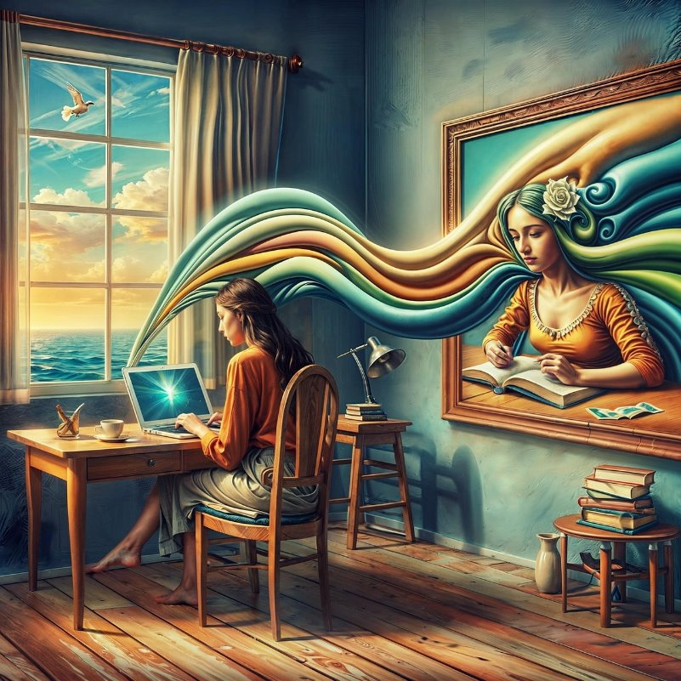
Between intimacy and control
1. "It cannot be a friendship"
2. The clinging author
3. The exception
Notes:
In this presentation I have shown that the publishing profession is centrally constructed by placing the publisher in relation to the author in various ways through boundary work
There are various ways of constructing authorship in the data, but here I have explored three central ones
Firstly, the relationship is constructed as a sort of "non-friendship": the boundary is drawn between the author and publisher by describing the friend-like aspects as not totally "genuine" but rather a tool for "professional work"
Secondly, the author is constructed as someone in need of emotional support: here, the boundary between author and publisher is drawn by constructing the publisher as "rational" and "supportive" and author as "emotional" and "in need"
Thirdly, the boundary can be drawn outside of the author-publisher dyad: this happens by constructing author as someone "exceptional": especially talented or famous. Sometimes this is also done in relation to authors that are the editor's "actual" friends also outside of the editorial relationship.
In the data, the "professional" relationship with the author consists of opposing poles where there are elements of intimacy but also of rationality, distance and control
The ideal of professionalism requires the publishers to place themselves in the intimate relationship but also to control it
Authors, on the other hand, are often constructed as not setting as strict boundaries and craving for deeper connection (that is, not sharing the same professional ideals)
However, author is also sometimes constructed of a magical being that allows the publisher to experience things above the everyday life: here, the control-aspect seems to lose it's meaning while author and publisher form an intimate dyad
Getting back to the headline of the presentation, "literary romances" can mean both the publisher's way of contructing author as someone prone to having crushes with the publishing professionals and the romanticizing aspects of constructing the relationship as some way "exceptional" or even "magical"

Slide 14
The double helix of literary publishing
The publisher and author can be seen as forming a double helix: they come to being together and depend on each other
The elements of intimacy and control keep the double helix both strained and energized
In self-publishing a single person could be considered carrying out both sides of the double helix. However, both functions must be implemented in order to create "the author"

Slide 15
Bibliography
Evetts, Julia (2013) Professionalism. Value and ideology. Current Sociology Review 61:5-6, 778-796.
Fournier, Valérie (2000) Boundary work and the (un)making of the professions. In Malin, Nigel (ed.) Professionalism, Boundaries and the Workplace, 67-86. London: Routledge.
Gieryn, Thomas F. (1983) Boundary-work and the demarcation of science from non-science: Strains and interests in professional ideologies of scientists. American Sociological Review 48:6, 781-795.
Halttunen, Kai (1995) Pienkustantajan arkipäivä. Jyväskylä: Nykykulttuurin tutkimusyksikkö.

Slide 16
Thank you!
Get in touch:
anne.molsa@tuni.fi
Notes:
Publisher-author double helix as "the DNA of literary culture"
I am happy to answer any questions either now or later in the chat

