Slide 1
AI, authorship and probabilistic systems of publishing
Dr Frania Hall, Media School, LCC, UAL.
IPRH

Slide 2
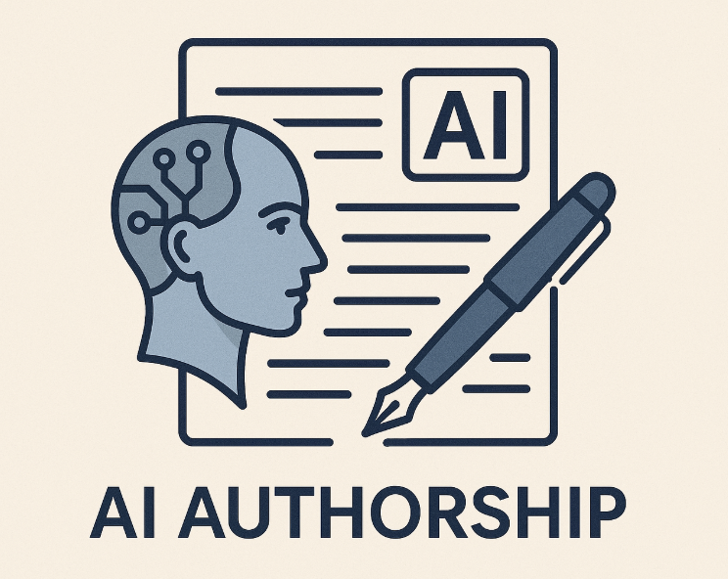

Slide 3
Introducing Barrett Williams
Background: Systems engineer, ex-US Air Force, Chief Information Officer.
Scale of Production: Over 4,400 titles published on Amazon
The 'Book Factory' Philosophy: "I’m not an author, I’m an engineer. I don’t write books, I manufacture them. I call this whole thing my book factory."
Primary Motivation: Driven by curiosity, systemic problem-solving and a desire to learn by building.

Slide 4






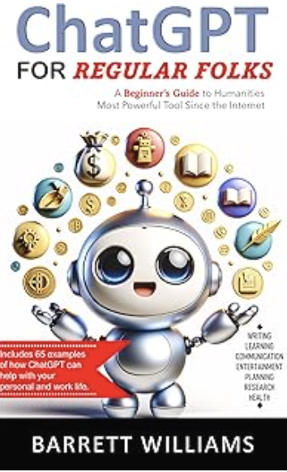



Variety

Slide 5
4 main themes emerging
Author identity
Probabilistic systems
Platform controls
Human/Machine interplay

Slide 6
‘My gut tells me the computer wrote it. I asked it to write it, and it wrote it. But should it be listed as an author? I don't know.’

Slide 7
Shift in author identity
Ethical Positioning: Clear, upfront transparency about using AI; deep respect for the creative effort and labour of traditional writers.
Changing Identity: The author shifts from a 'singular creator' to an orchestrator of systems who manages generative probability
Modelling traditional publishing: Creates workflows and agents that map onto publishing systems and includes structures, paratexts expected for books

Slide 8
‘They consistently get about a 3.6-star rating, which isn't five stars, but considering the books are written by a computer, I think that's amazing.’

Slide 9
Probabilistic system
Probabilistic Gatekeeping: Produce at scale first, then let the marketplace filter AFTER publication based on reader reaction.
Quality Metrics: Consistent 3.6-star Goodreads/Amazon rating is 'good enough’ - it is adequate for enough readers.
Readers choose: Easy Amazon refund options, free in unlimited subscriptions packages – readers stay in control
Publisher as Probability Manager: Shift from manual curation and editing to managing automated content metadata and launch frequency.

Slide 10
‘Amazon puts a huge barrier between me and my readers. There's no interaction. I don't know who they are’

Slide 11
Platform controls
Amazon Policy Tension: Amazon's rules prevent listing 'ChatGPT' as an author, forcing books to be listed under a human's name
No access to readers: You do not know readers and cannot get feedback, making metadata, titles, and cover design critical for discovery.

Slide 12
‘An agentic system is where you spawn different AI instances that specialise. That's just division of labour, the same principle humans follow’

Slide 13
Human/Machine Interplay
Human/Machine collaboration – act of publishing is distributed across a network—human prompts, AI models, and platform constraints.
Publishing becomes a collaborative, hybrid system of algorithms, platform rules and marketplace feedback.
Machines allow new entrants to participate in publishing activity in new ways, when previously exclusive

Slide 14
Conclusions
Author as engineer
Concurrent approach to publishing - separate track not aiming to compete
Identity is consciously separate and different – avoiding ethical issues
Readers in control – sidesteps issues around originality and value
Genuine, engaged, thoughtful approach to alternative publishing models

